Slide 1
Working and Comparison between K-Means Clustering and K-Nearest Neighbor

Slide 2
Contents
Scope of the work
Few words about Machine Learning
K Means Clustering
K Nearest Neighbor
How they are working together
Conclusion
Acknowledgement

Slide 3
Scope of the work
In this project we have implemented two algorithms known as “K-Means Clustering” and “K-Nearest Neighbor” which are usually applicable in the domain of Machine Learning and Artificial Intelligence.

Slide 4
Features of Machine Learning
Learning from the past interactions.
Making assumptions depending upon
knowledge base.
Creating Intelligence to solve real-life
problems.

Slide 5
Use of Algorithm in the field of Machine Learning
Algorithm helps to:
Build the base for the learning of a system.
Build the base for applying the knowledge on
a certain data.
Build the base for solving real life problems.

Slide 6
K-Means Clustering (Overview)
This is a clustering algorithm. Cluster means small groups of data having different properties. These groups are created over a large dataset with the help of corresponding algorithms. In K-Means clustering the k value refers to the no. of clusters to be created.

Slide 7
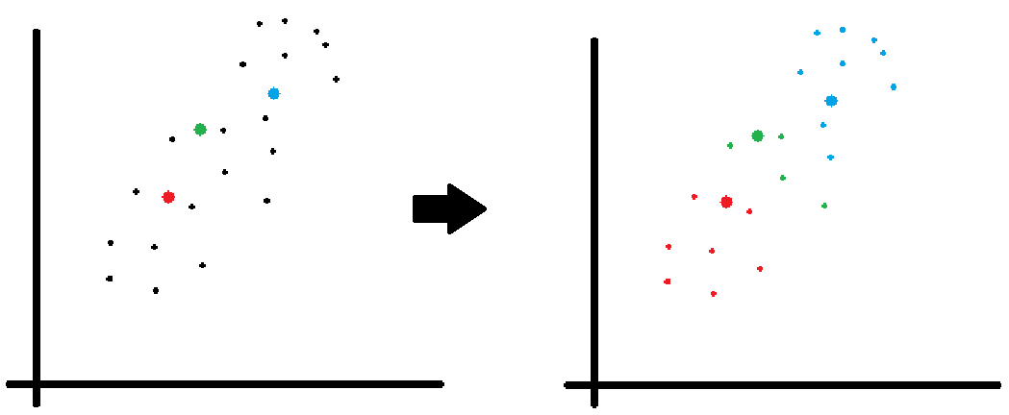
K-Means Clustering (Functionality)

Slide 8
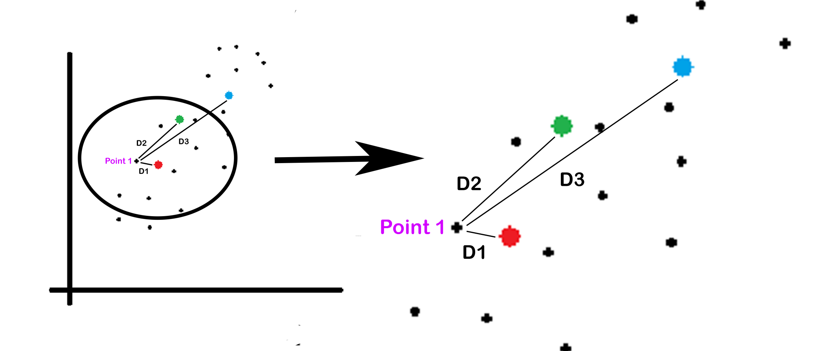
K-Means Clustering (Working Structure)

Slide 9
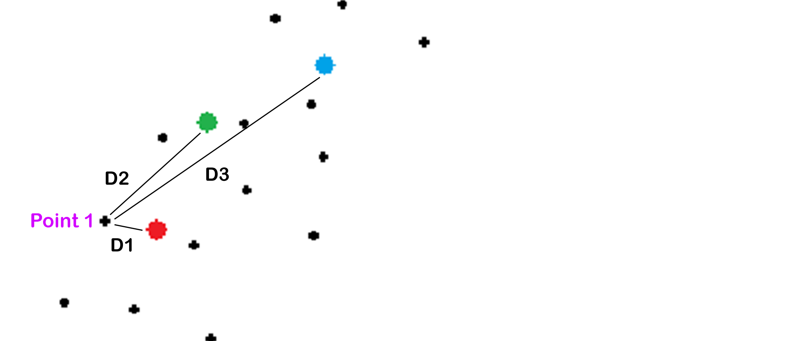
K-Means Clustering (Working Structure)
= min(D1,D2,D3)
= D1
Nearest centroid = RED
Cluster_value (Point 1) = RED

Slide 10
K-Means Clustering (Working Structure)

Slide 11
K-Means Clustering (Advantage)
Ability of working with big datasets.
Simple yet efficient working structure.
Easy to implement using various libraries.
Able to make clusters of different shapes
and width on the basis of the dataset and the
k value.

Slide 12
K-Means Clustering (Disadvantage)
Manual input of k makes it partially
automated.
Efficiency depends upon k value.
Lacks efficiency for clusters with different
width.

Slide 13
K-Nearest Neighbor (Overview)
This is a classification algorithm which classifies a certain test data into a class depending upon a clustered reference data. This algorithm checks which class has the maximum no. of nearest neighbors of the test data. Here k means the no. of neighbors to be found.

Slide 14
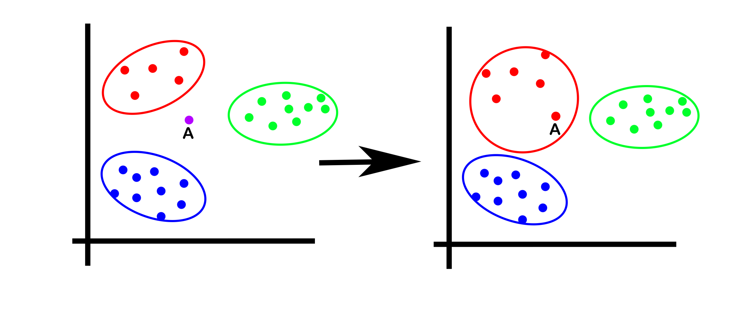
K-Nearest Neighbor (Functionality)

Slide 15
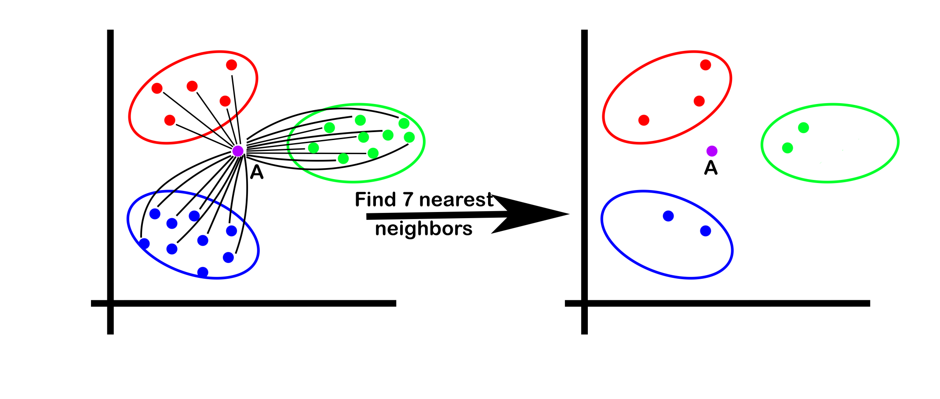
K-Nearest Neighbor (Working Structure)

Slide 16
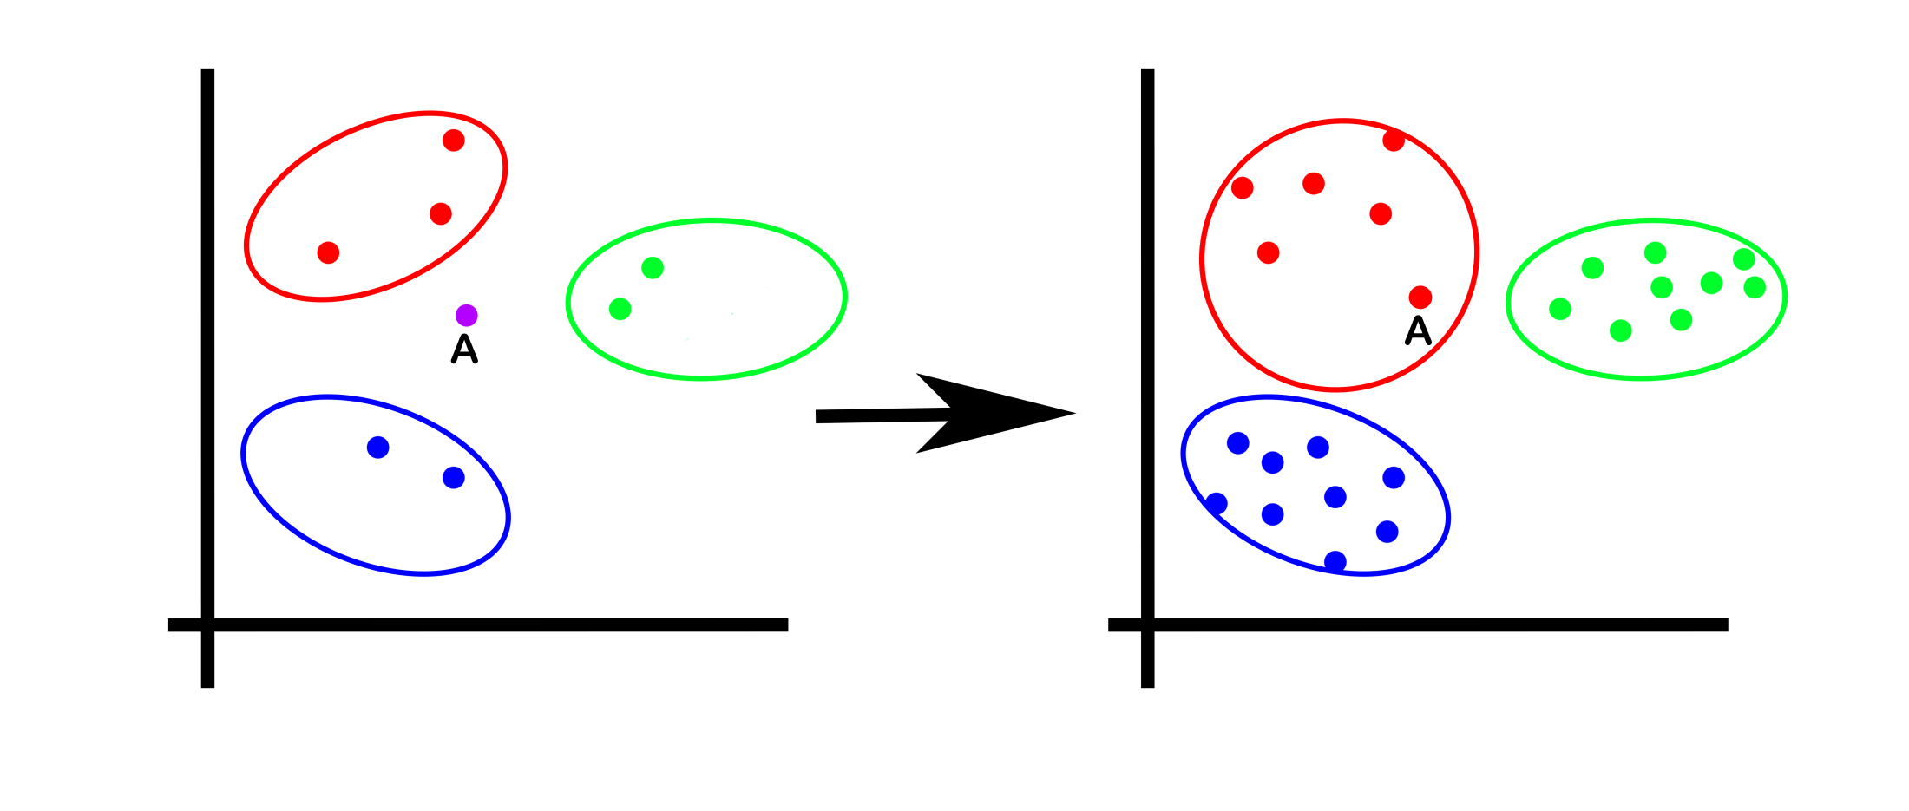
K-Nearest Neighbor (Working Structure)

Slide 17
K-Nearest Neighbor (Advantage)
Faster execution.
Simple yet efficient working structure.
Easy to implement using various libraries.
Applicable for regression & classification.
Highly accurate for classification.

Slide 18
K-Nearest Neighbor (Disadvantage)
Accuracy is based on the reference dataset.
Efficiency is lesser while using large data.
Larger storage requirement in case for large
reference data.

Slide 19
Association of K-Means & KNN
Here in this project we first use K-Means
clustering to cluster a dataset into
certain clusters.
Then we use that clustered dataset as the
reference data for KNN.
Then we use KNN to find the cluster or
class value of a given test data point.

Slide 20
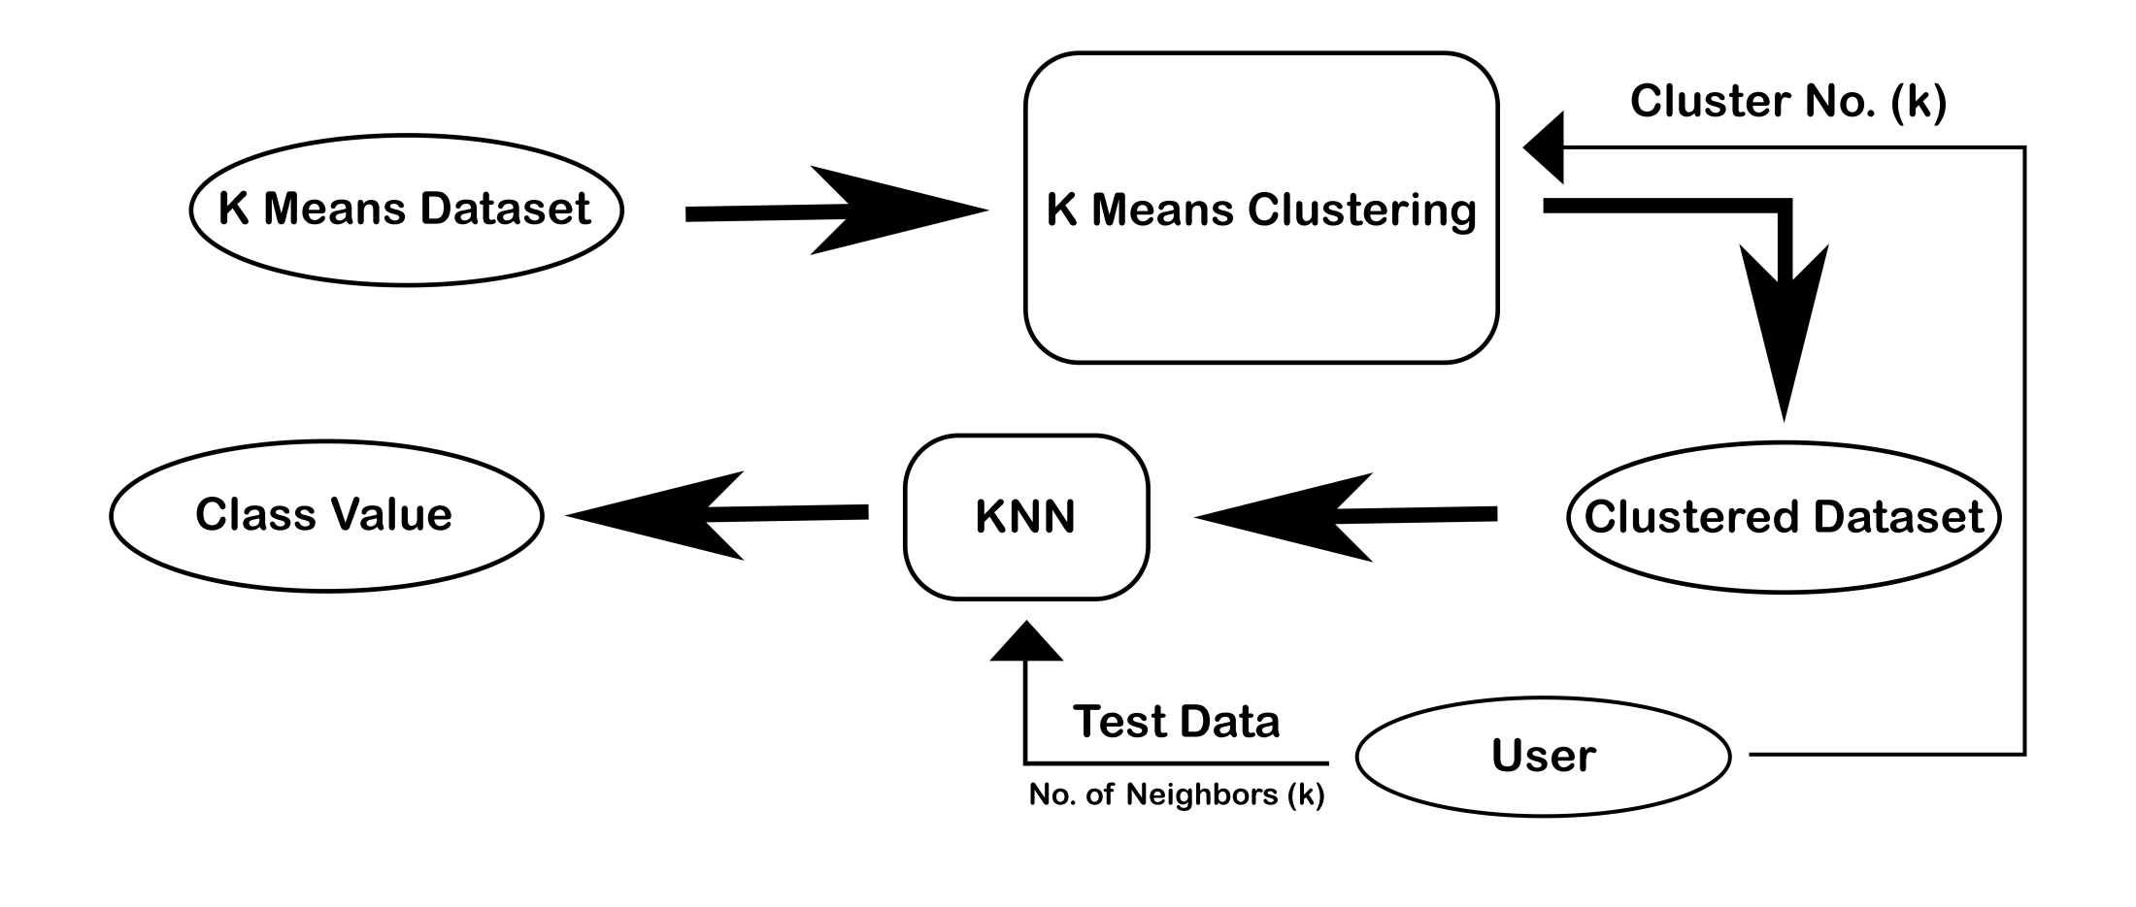
Let’s Understand

Slide 21
Let’s Visualize
DATASET

Slide 22
Let’s Visualize
Cluster

Slide 23
Let’s Visualize
Test Data

Slide 24
Let’s Visualize
5 Nearest Neighbors

Slide 25
Let’s Visualize
Classified to class 3

Slide 26
Conclusion
Steps our first feet into the world of
Machine Learning.
Learned about how machine learns
from past interactions.
Learned how real life clustering takes
place in our daily lives.

Slide 27
Acknowledgement
Special thanks to our supervisor Mr.
Tanmoy mete.
Thanks to the team members.
Thanks to our friends in college.
Thanks to the websites and channels
that helped us to understand our work
more precisely.

Slide 28
Reference
http://abhijitanaldas.com/ml/kmeans-vs-knn-in-machine-
learning.html
https://datascienceplus.com/k-means-clustering/
https://amete.github.io/DataSciencePortfolio/Udemy/Python-DS-and-ML-Bootcamp/K_Means_Clustering_Project.html
https://geeksforgeeks.com
https://tutorialspoint.com
https://w.saedsayad.com/clustering_kmeans.htm
Edureka Youtube Channel

